Slide 1
Phylum Chordata
Class – Pisces (Fishes)
Two types of fish
Cartilaginous fishes and Bony fishes

Slide 2
Cartilaginous fishes have cartilaginous skeleton
They do not have a swim bladder so that they must keep swimming
They are viviparous – live bearers.

Slide 3
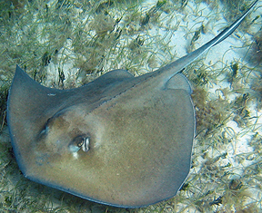
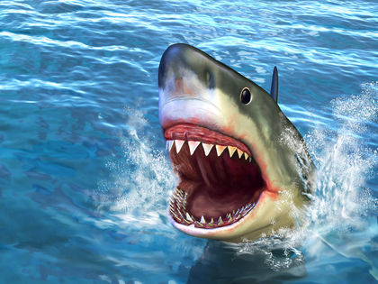

Slide 4
Bony fishes
have bony skeleton
have spindle shaped body
Respire through gills
have scales in the body
have a swim bladder help them to rise and sink
have two chambered heart

Slide 5
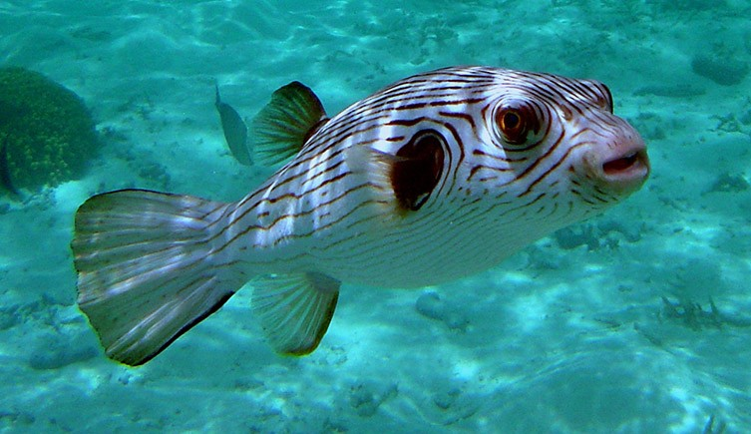

Slide 6
Class Amphibia
They live in water and on land
They have smooth and moist skin
No scales present
They have two pairs of limbs
Their heart is three chambered.

Slide 7
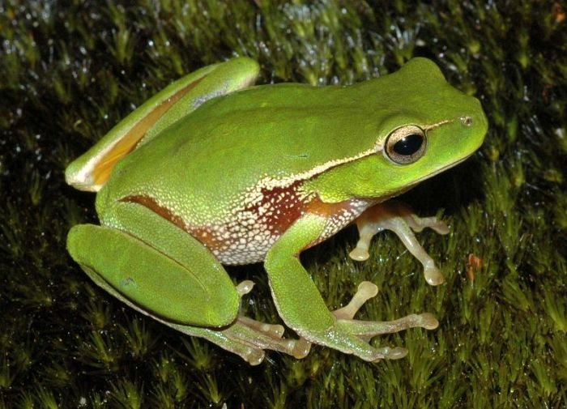
Ex: Tree frog

Slide 8
Class Reptilia
They have dry horny scaly skin
They have two pairs of limbs
Their heart is three chambered

Slide 9
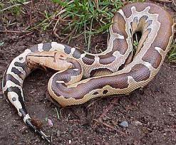
Ex: Python

Slide 10
Class Aves
Distinct feature of birds is flight
Characteristic features that help the birds in flight
They have a stream lined body covered by feathers to help to reduce the resistance.

Slide 11
The fore limbs are modified into wings. They are also covered by feathers
Have light, porous bones with air cavities to reduce the weight
Have a strong breast bone called keel to which the flight muscles are attached
Heart is four chambered which allows complete separation of the oxygenated blood from the deoxygenated blood.

Slide 12
Hind limbs are adapted for perching
The tail is used for changing the direction
Have a constant body temperature called warm blooded.
They maintain a high metabolic rate in order to lift off the body from the ground
The heart of the birds beats faster in order to supply large amount of oxygenated blood into the body

Slide 13
Have large eyes and strong sense of sight. The field of vision is also great.
They have a remarkable ability to judge the distance from a close range as well as from a great height
The disappearance of right ovary and right oviduct reduces weight and is an adaptation for flight.

Slide 14
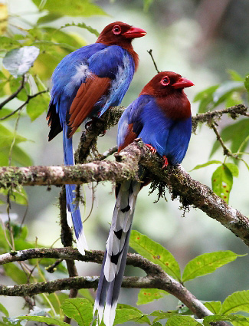
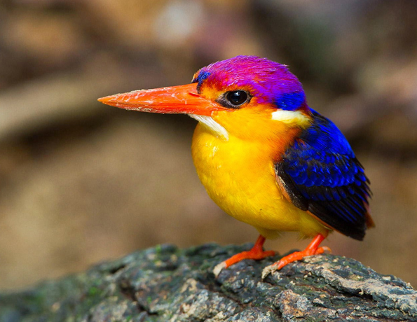

Slide 15
Class Mammalia
They are viviparous and nourish the young ones with milk secreted from mammary glands
Body is covered with hair
External ear present
Spiny ant eater is an exceptional that Egg laying mammal

Slide 16
Remarkable mammals
Spiny ant eater is an egg laying mammal
In kangaroo, young ones are 3cm long when born. They crawl into the pouch and feed on the milk
Shrews are the smallest, insectivorous mammals

Slide 17
Bats are flying mammals. Their fore limbs are modified into wings
Whales, Dolphins are aquatic mammals. Fore limbs are modified in to flippers
Man, Monkey, Gorilla are highly evolved mammals. They have opposable thumb. Intelligent animals

Slide 18
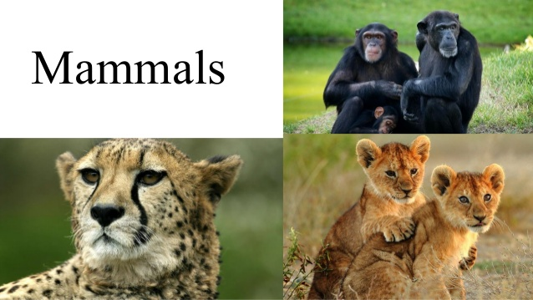

Slide 19
Thank you!

